Slide 1

AB Test Evaluation
For Outdoor Retailer
Data Scientist: Jon Nguyen

Slide 2
Recap
Goal: Improve premier hiking product sales by using a popup when hiking gear was added to cart
Premier product sales improved, but overall conversion (orders/unique visitors) and overall revenue fell
How to iterate? Keep improved premier line sales without sacrificing overall revenue.
Overall
Premier

Slide 3
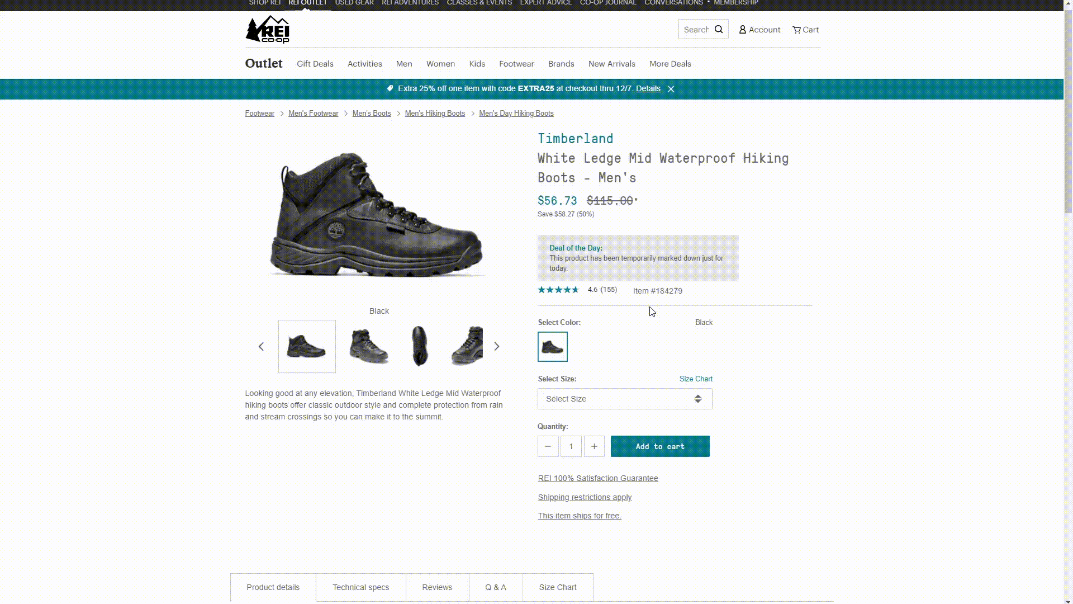
Less Intrusive Approach
Suggested Items at:
Bottom of product page
Cart addition confirmation
Checkout
Doesn’t have to be limited to one product line
Accenture study: 58% of users more likely to purchase when retailer recommends products based on purchase history
Source: Accenture (2016)

Slide 4
Recommendation System
Collaborative filtering
User behavior: search for/purchase similar things
AWS Elasticsearch
Content-Based Filtering
Product and user meta-data, clustering
Hybrid combination of the two
Design

Slide 5
Exploratory Analysis
Target: Upgrade and Purchase
Tableau Dashboard

Slide 6
Limitations of current dataset
No control group data, need to analyze variance
Data is only from a couple months, can’t show seasonality well
Some loose inaccurate definitions in the data key
Lacking user history
Lacking non-purchase information

Slide 7
Class Imbalance

Slide 8
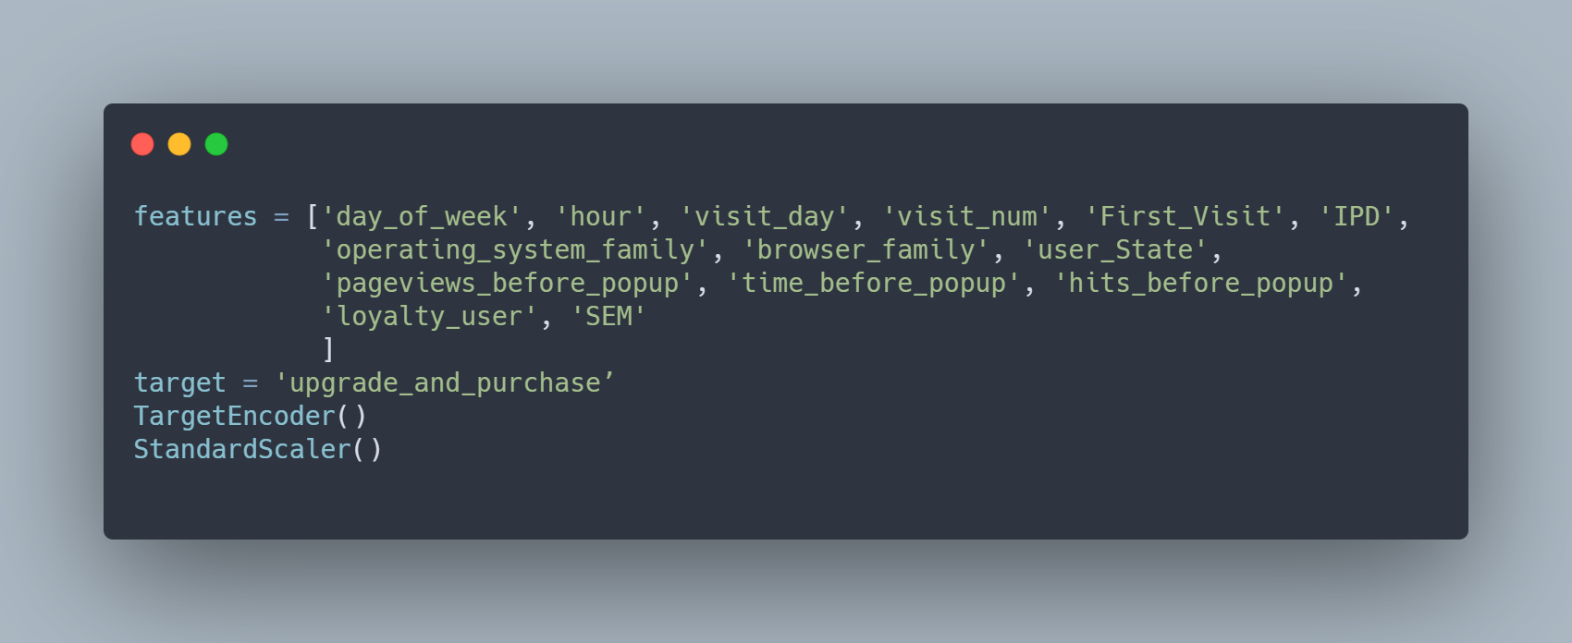
Data Processing

Slide 9

Models
Logistic Regression
Random Forest Classifier
Neural Network
Stochastic Gradient Descent Classifier

Slide 10
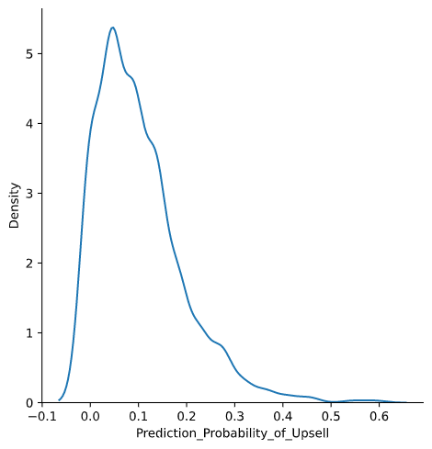
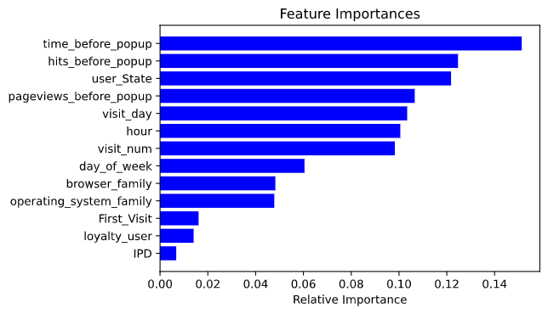
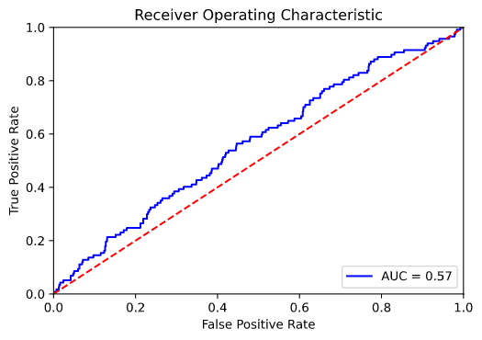
Results

Slide 11
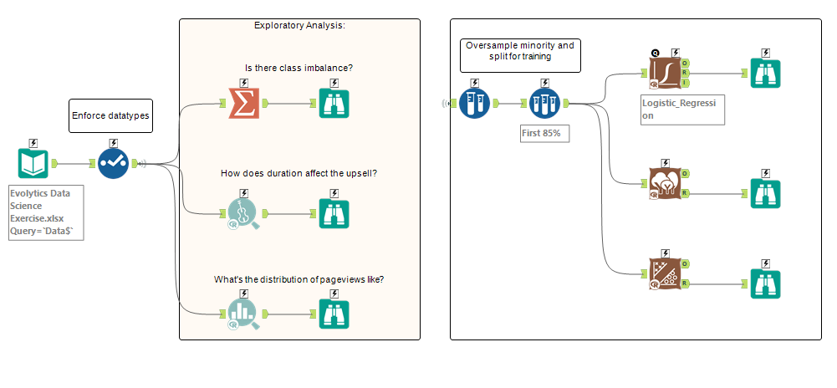
Alteryx

Slide 12
API Endpoint
Website tracks data about the user
Send information to API endpoint
Receive a probability of upsell
Decide to show popup based on threshold

Slide 13
Summary
Less intrusive Upsell
Recommendation system
Not limited to one product line
Based on user and/or product data
Predict probability of upsell
Need more data, user purchase history
Show message based on set threshold
Done via API response

Slide 14
Appendix
Assumptions: A/B testing was done by selecting random unique visitors and assigning to control and experimental groups. Variance of control group was such that the comparisons were valid to experimental results. Observations in the dataset were independent of one another.
Derksen, Jens. 2016. Accessed 2020. https://newsroom.accenture.com/news/consumers-welcome-personalized-offerings-but-businesses-are-struggling-to-deliver-finds-accenture-interactive-personalization-research.htm

